Slide 1

SCHOOL OF COMPUTING
DEPARTMENT OF ARTIFICIAL INTELLIGENCE
AND MACHINE LEARNING
TECHTONIC SHIFT’24
PARKING SPACE APPLICATON
BASED ON IOT
TEAM ID: TS28
Jones Andrew.E VTU20674
Sundar Raj.B VTU20676

Slide 2
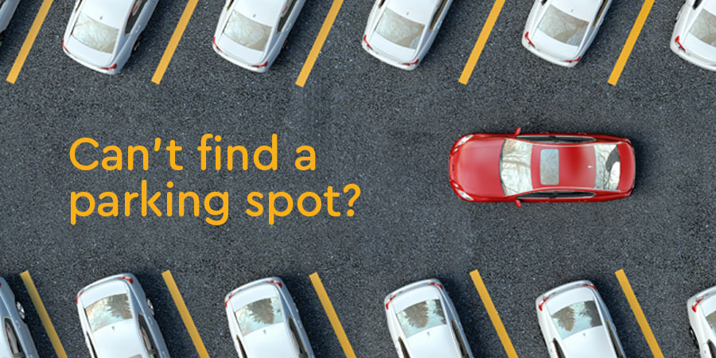
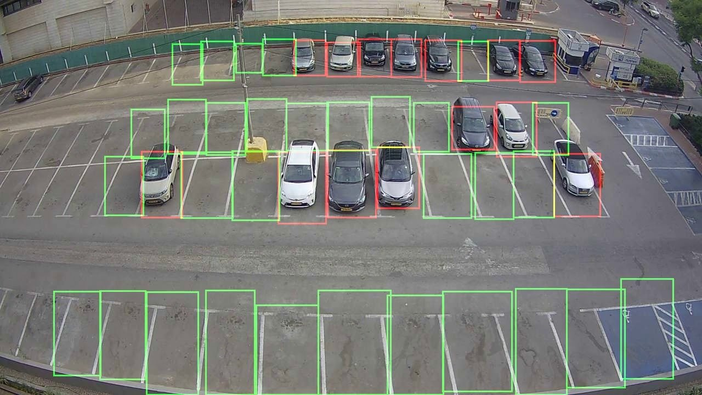
Problem Statement and Solution Overview
The overall aim is to provide a human less parking experience.
Most of the parking systems are bungled and inefficient.
The users have to remember their parking spots in huge parking spaces.
Calculation of parking charges for each and every vehicle
Huge lines waiting to pay the parking charges.
The free parking spaces are detected using the computer vision model-YOLO V8.
The parking space is updated in the app for users to see and park their vehicle.
The parking charges is calculated based on the vehicle number and the parking time.

Slide 3
Technologies used/Approach
YOLO V8 algorithm ( you only look once) is an computer vision algorithm which is used here to detect the empty spaces in the given parking lot .It uses the live video from the parking lot, extracts the frames from the video and detect the empty spaces available to park our vehicle.
An app is created using React Native which displays the available parking spaces to the users. Furthermore the app also gives the charges based on the entry and exit time. Payment options will be provided.
The app runs on Google cloud platform which is one of the fastest servers with quick and immediate request response cycle. The cloud acts as the backend for the application which hosts the YOLO v8 model as well.
The deep learning model is built on python and the app is built entirely on JavaScript. The google cloud uses SQL to store structured data.

Slide 4
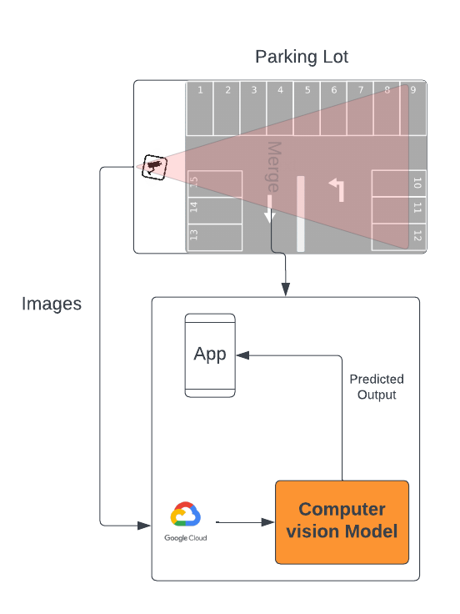
Block Diagram

Slide 5
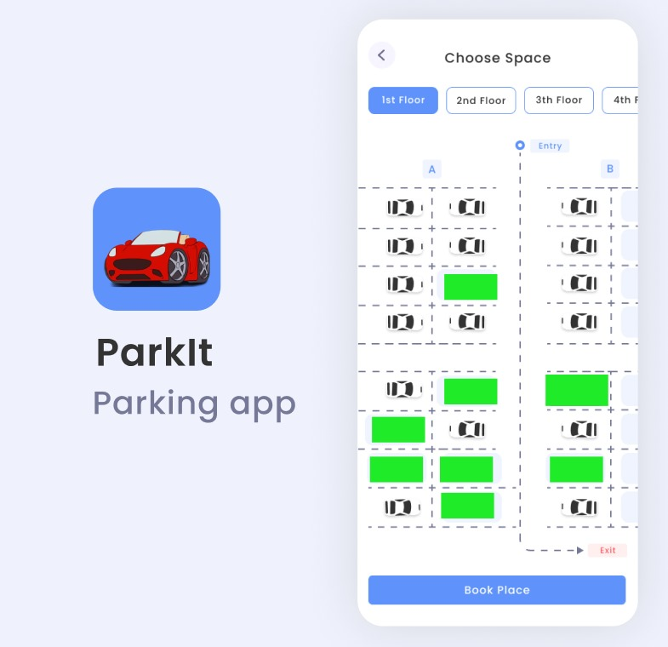
Photos and Videos

Slide 6
Important pointers
Efficient Resource Management: This project helps to ensure effective resource management by accurately determining parking space vacancies in real-time. It supports the best possible use of parking spots, lessening traffic jams and enhancing overall traffic flow.
Improved User Experience: For drivers, finding available parking spaces can be a frustrating experience. This project enhances user experience by providing real-time information about parking space availability, reducing the time and effort required to find a parking spot.
Environmental Benefits: By reducing the time spent searching for parking spaces, this project can help decrease fuel consumption and emissions associated with vehicle circulation in search of parking. This contributes to environmental sustainability by reducing the carbon footprint of urban transportation.
Scalability and Flexibility: The use of google cloud allows for scalability and flexibility in deploying and managing the parking space detection system. It can easily update changes in the number of parking spaces, adapt to different environments, and integrate additional features in the future.

Slide 7
Components used and cost details
S.No | Name of Component | Price
1 | Raspberry pi 4 model B | 10000
2 | Google cloud storage | 320 (6 months)
3 | Raspberry pi camera v2 | 5000
4 | Google Play store | 3000

Slide 8
THANK YOU

